Slide 1
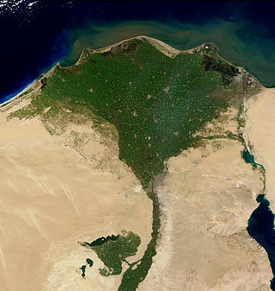
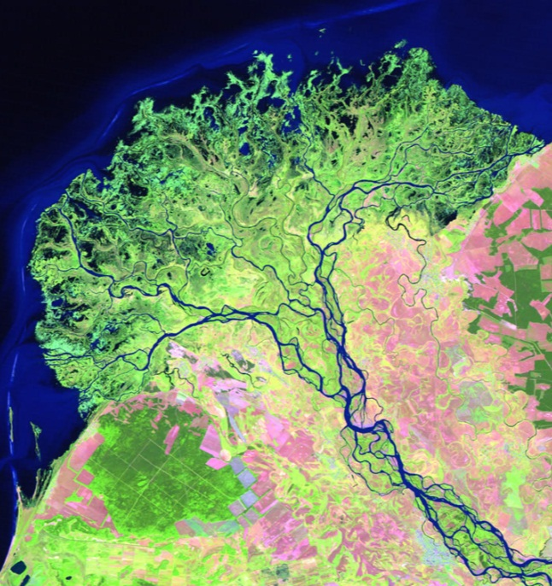
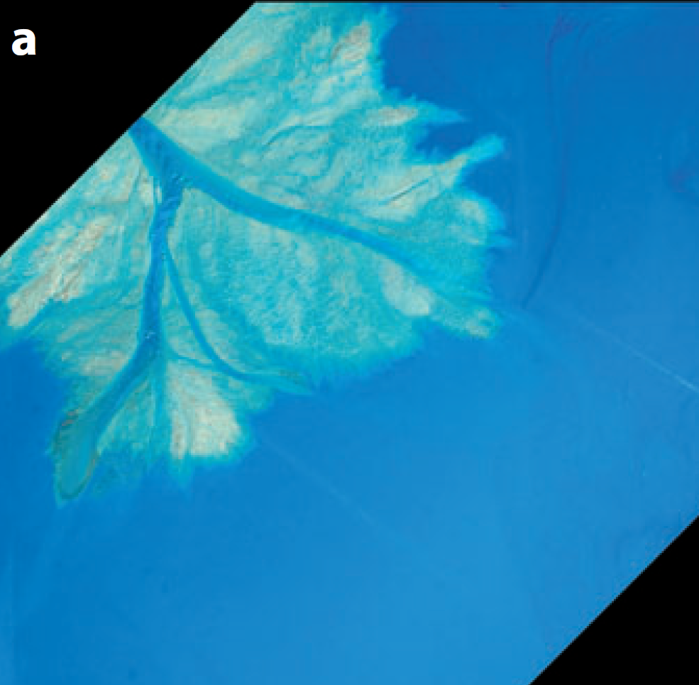
What sets the size of river deltas?
100 km
10 km
0.5 m
Nile River,
Egypt
Selenga River, Russia
Paola et al., 2010
Michael Lamb
Assistant Professor of Geology
California Institute of Technology

Slide 2



Acknowledgements
Contributed to this research:
Phairot Chatanantavet, Vamsi Ganti, Zhongxin Chu, Hima Hassenruck-Gudipati, David Mohrig, Jeff Nittrouer, John Shaw, Roman DiBiase, Joel Scheingross, Ajay Limaye, and Woody Fischer.
Funded this work:

Slide 3
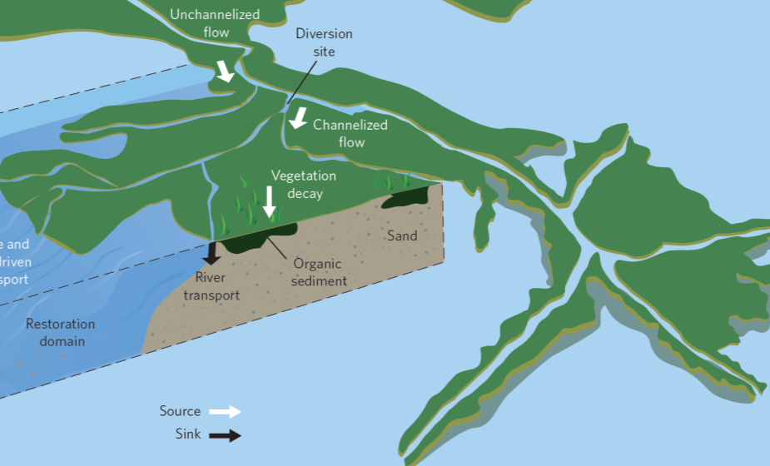
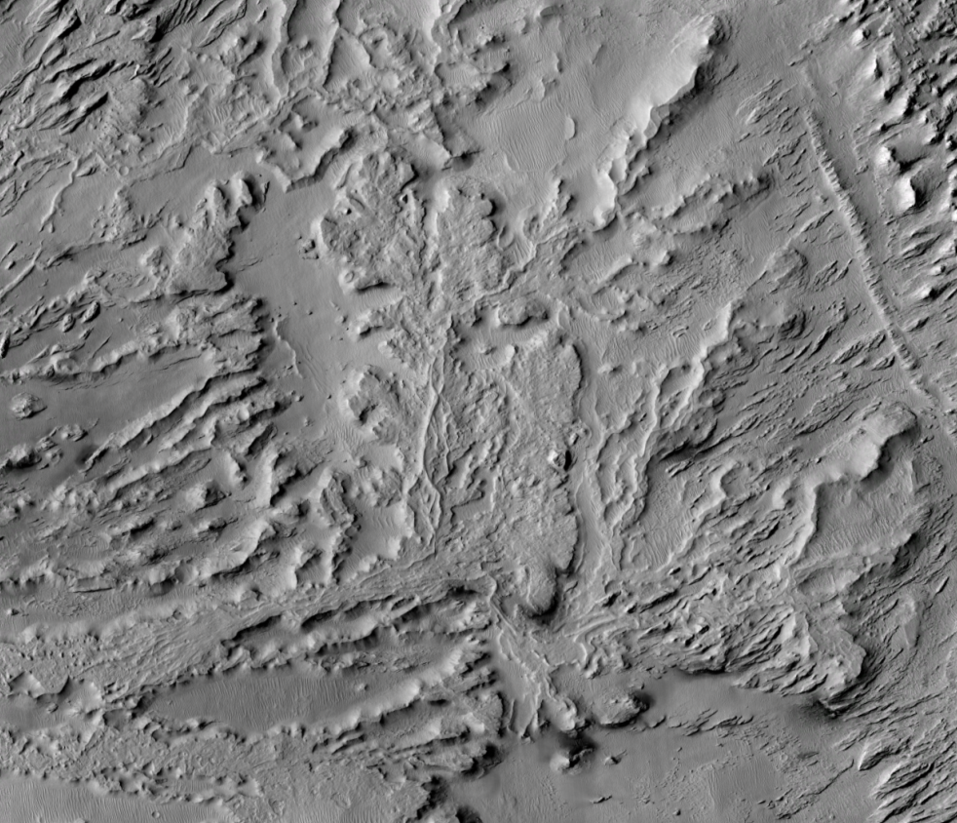
We need theories for delta size
Sustainability
More than half a billion people inhabit deltas.
Owing to their low slopes, deltas are susceptible to dramatic land loss and storm inundation due to small imbalances in sediment supply, sea-level rise, and land subsidence.
Sediment is the key natural resource, and we must understand how it is distributed.
Paleo-environmental reconstruction
What do deltas tell us about past environments, water and habitability on Earth and Mars?
Do larger deltas indicate more water?
What sets delta size?
Mississippi Delta, USA
(Edmonds, 2012)
Aeolis Dorsa Region, Mars
10 km
NASA / ESA

Slide 4
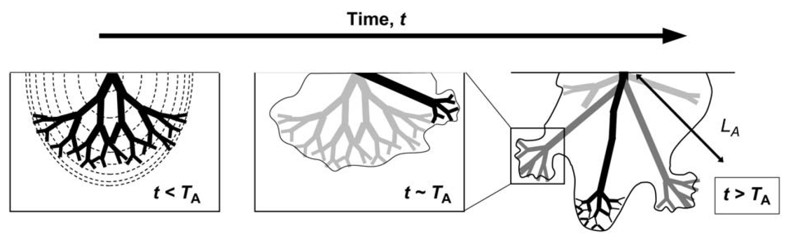
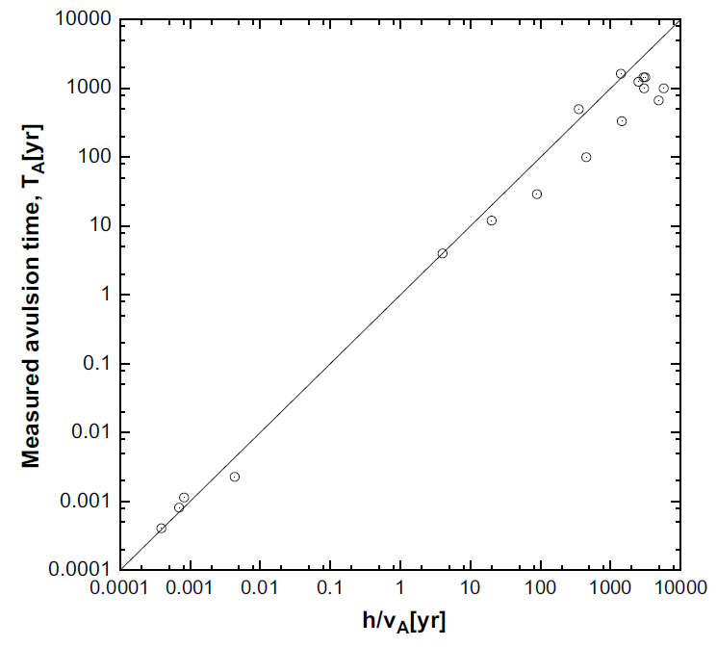
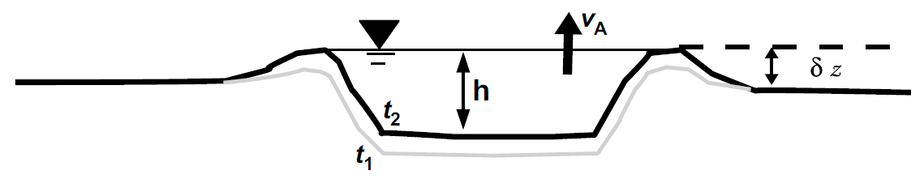
Avulsion is the main process that sets delta size
Jerolmack, 2009
Avulsion timescale (T_{A}) is set by the time to fill ~ 1 channel depth
Jerolmack, 2009
(Tornqvist, 1993; Jerolmack and Mohrig, 2007)

Slide 5
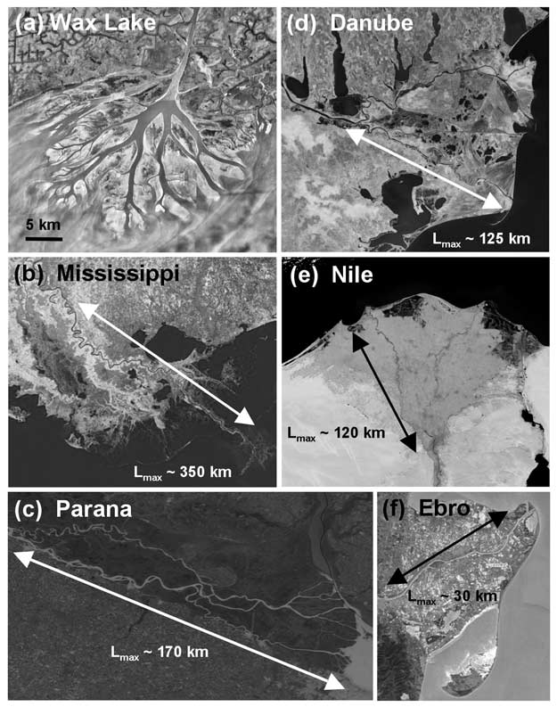
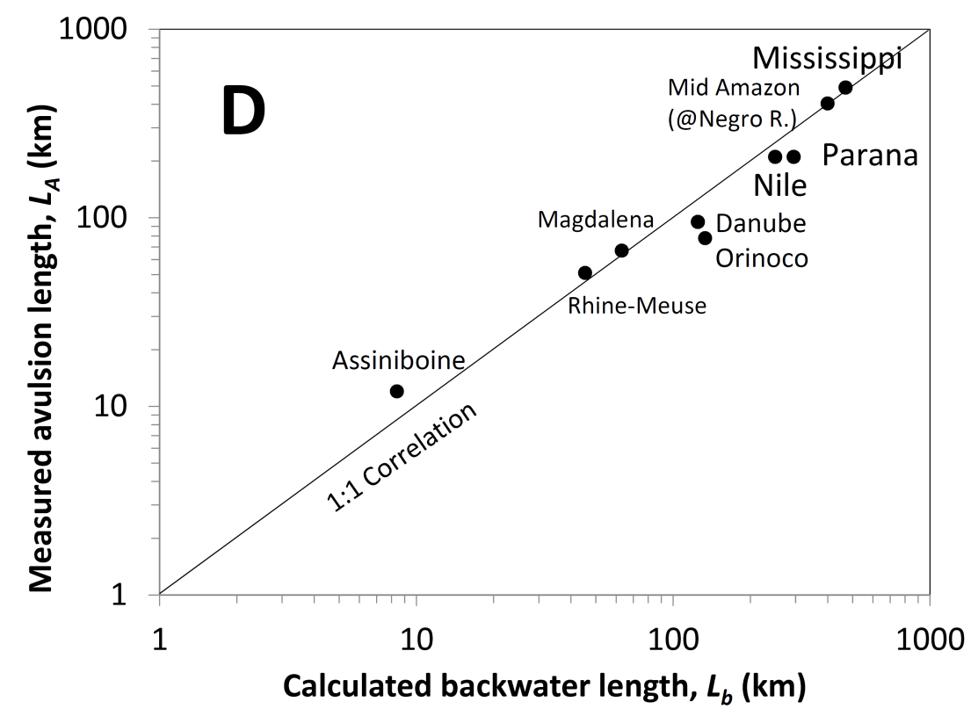
A worldwide data compilation suggests that delta size is set by backwater dynamics.
L_{b} = h / S
(Jerolmack and Swenson, 2007)
(Chatanantavet, Lamb and Nittrouer, 2012)
Why does this correlation exist?

Slide 6
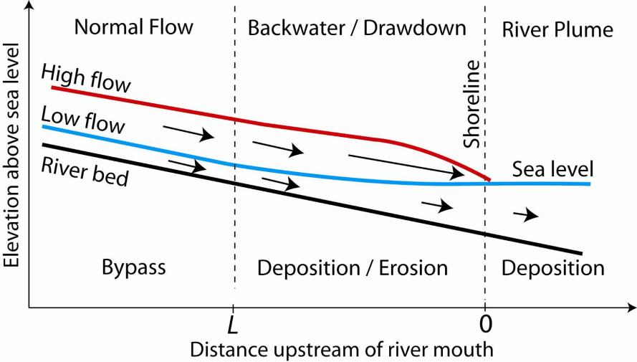
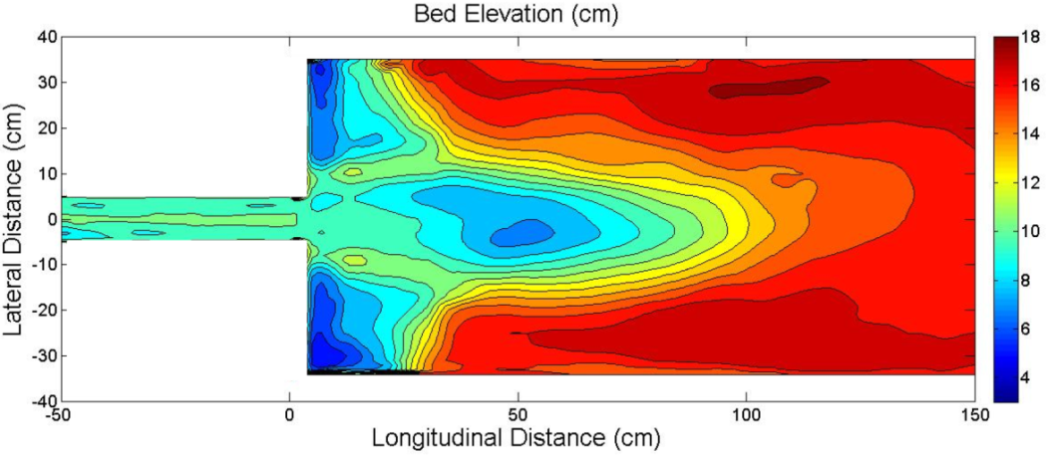
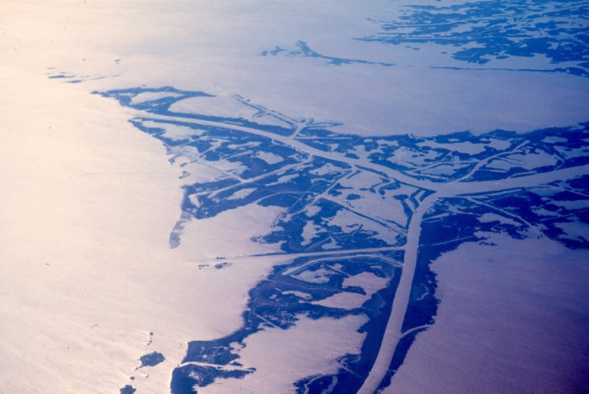
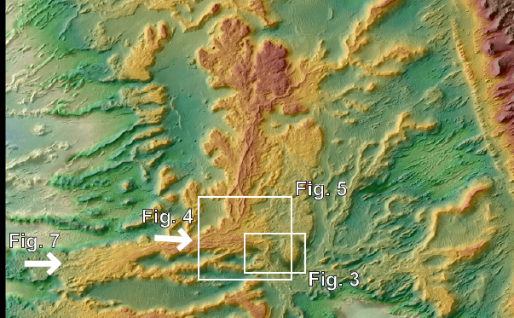
Outline: Backwater and delta size
1. Introduction to backwater dynamics
2. Numerical model and flume experiments
3. Application to Mississippi Delta
4. Application to Mars

Slide 7
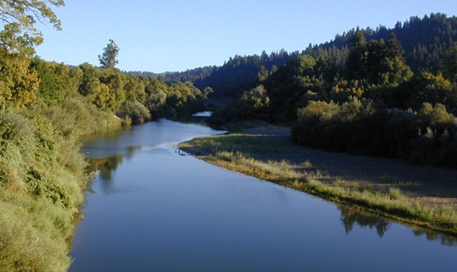
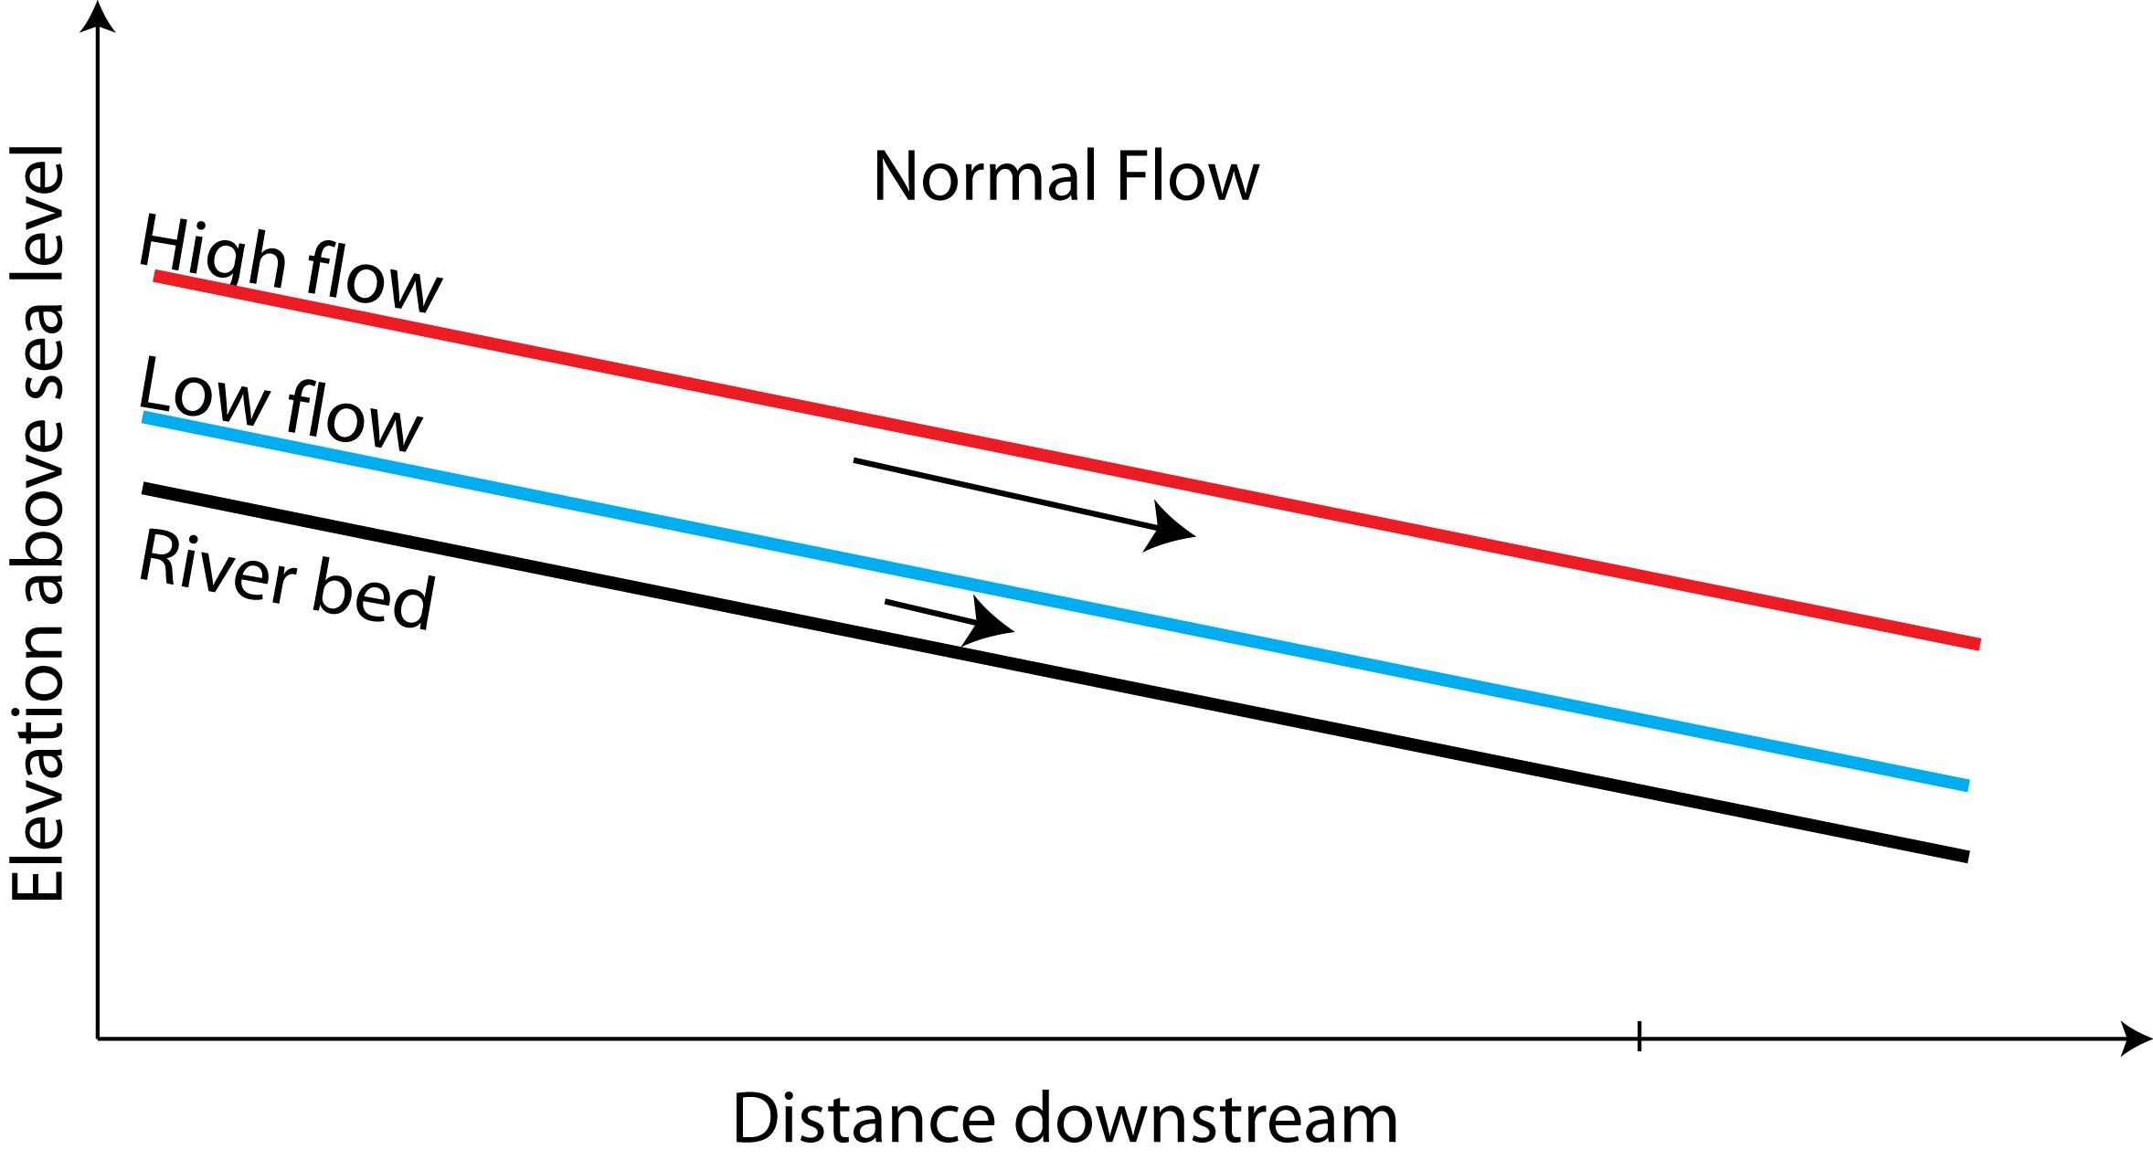
Normal flow approximation for fluvial hydraulics and sediment transport
Russian River, CA
Normal flow approximation:
Steady and uniform flow
Water surface and bed are parallel
River floods accommodated mostly by larger stage heights
Assumption made in most fluvial-deltaic morphodynamic models and experiments (e.g., see Paola 2000 for discussion).
Deposition at river mouths is forced by delta progradation, subsidence or sediment supply.

Slide 8
Transition to coastal rivers
Mississippi R. Delta
(Lamb et al., 2012)
Backwater hydraulics:
Non-uniform flow can extend 100s km upstream
Water surface and bed are not parallel
River floods accommodated mostly by changes in water surface slope (Nittrouer et al., 2012)
Spatial acceleration directly influences patterns of erosion and deposition (in the absence of delta progradation, subsidence, and changes in sediment supply).

Slide 9
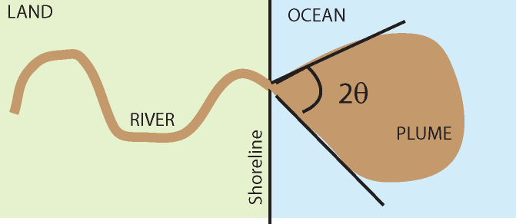
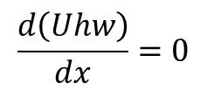
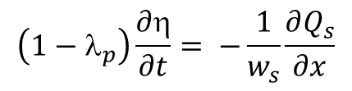
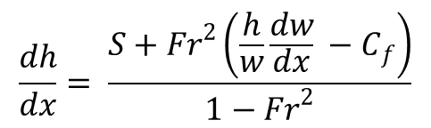
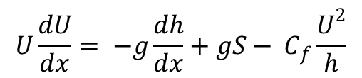
Numerical Model and Flume Experiments
Fluid continuity
$$\frac{d\left(Uhw\right)}{dx}=0$$
$$\frac{dh}{dx}= \frac{S+{Fr}^{2}\left(\frac{h}{w}\frac{dw}{dx} −{ C}_{f}\right)}{1−{Fr}^{2}}$$
Fluid momentum conservation
$$U\frac{dU}{dx}= −g\frac{dh}{dx}+gS− C_{f}\frac{U^{2}}{h}$$
Bedload transport
(Wong & Parker, 2006)
Bed evolution
$$\left(1−λ_{p}\right)\frac{∂η}{∂t}= −\frac{1}{w_{s}}\frac{∂Q_{s}}{∂x}$$
(Lamb et al., 2012, JGR; Chatanantavet et al., 2012, GRL)

Slide 10
Experimental setup
Fr < 0.5
Subcritical Flows:
Oscillate between high and low discharge events.
Sea-level is fixed.
Sediment and water fluxes are set to be in balance.
Under the normal-flow assumption, both high and low flows should have equivalent bed slopes and no erosion should occur.
Thus, any erosion or deposition is due to backwater effects alone (rather than changes in base-level).
Experimental Runs
drawdown
drawdown
3.4
Discharge (l/s)
backwater
1.72 hrs
7.25
hrs
1.5
8.0
hrs
Time

Slide 11
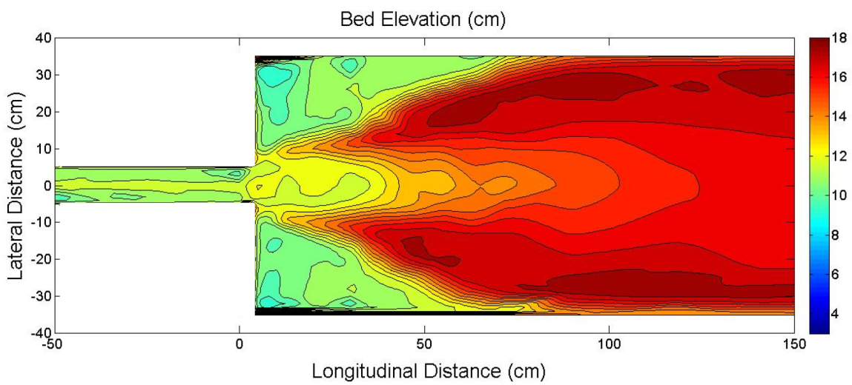
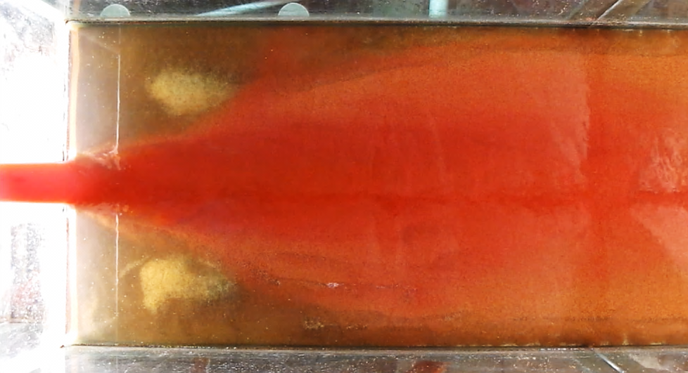

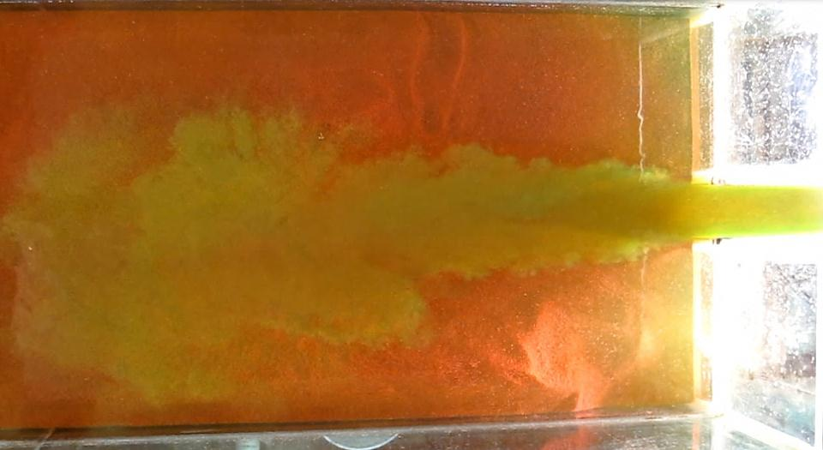
Experimental results: High flow causes bed scour and channelization in the offshore subaqueous delta
Low-flow bed elevation
levee
Plume
levee
High-flow bed elevation
Scoured channel
Plume
Chatanantavet and Lamb, in review, JGR

Slide 12
Low flow: Filling of high-flow scour
Water flow
Modeled river bed
Delta
Measured river bed
RIVER
PLUME
Chatanantavet and Lamb, in review, JGR

Slide 13
Low flow: Filling of high-flow scour
Water flow
Chatanantavet and Lamb, in review, JGR

Slide 14
Low flow: Filling of high-flow scour
Water flow
Chatanantavet and Lamb, in review, JGR

Slide 15
Low flow: Filling of high-flow scour
Water flow
Note constant bed slope between low and high flows
Chatanantavet and Lamb, in review, JGR

Slide 16
High flow: Scour of low-flow deposits
Modeled river bed
Water flow
Measured river bed
Delta
RIVER
PLUME
Chatanantavet and Lamb, in review, JGR

Slide 17
High flow: Scour of low-flow deposits
Chatanantavet and Lamb, in review, JGR

Slide 18
High flow: Scour of low-flow deposits
Chatanantavet and Lamb, in review, JGR

Slide 19
High flow: Scour of low-flow deposits
Enhanced scour just offshore
Chatanantavet and Lamb, in review, JGR

Slide 20
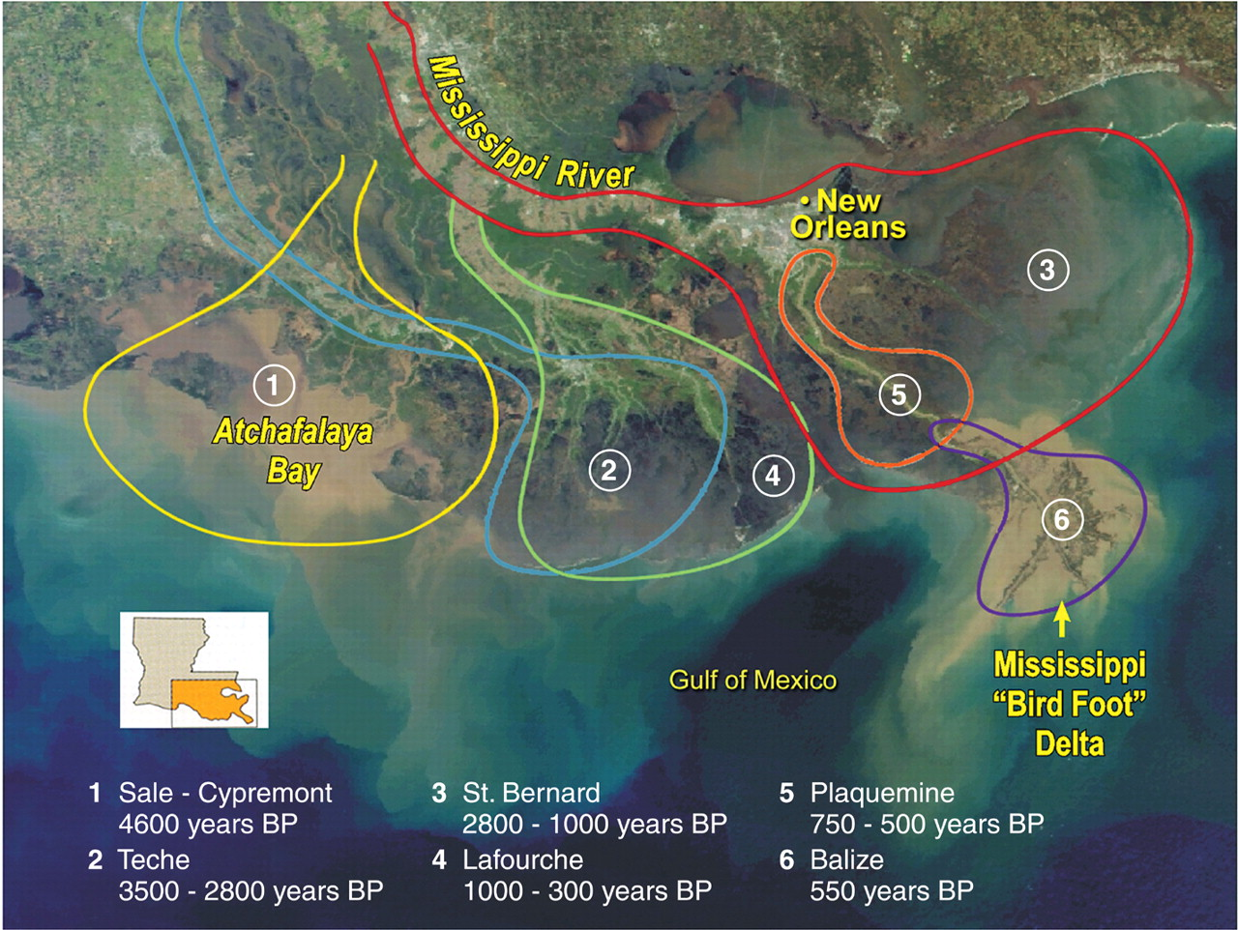
Application to Mississippi River
(Nittrouer et al., 2011)
L_{A} = ~500 km
After Coleman (1988)
Lower ~ 500 km is the backwater zone which is coincident with the avulsion node
Lower ~ 150 km shows evidence for active sour into “rock”

Slide 21
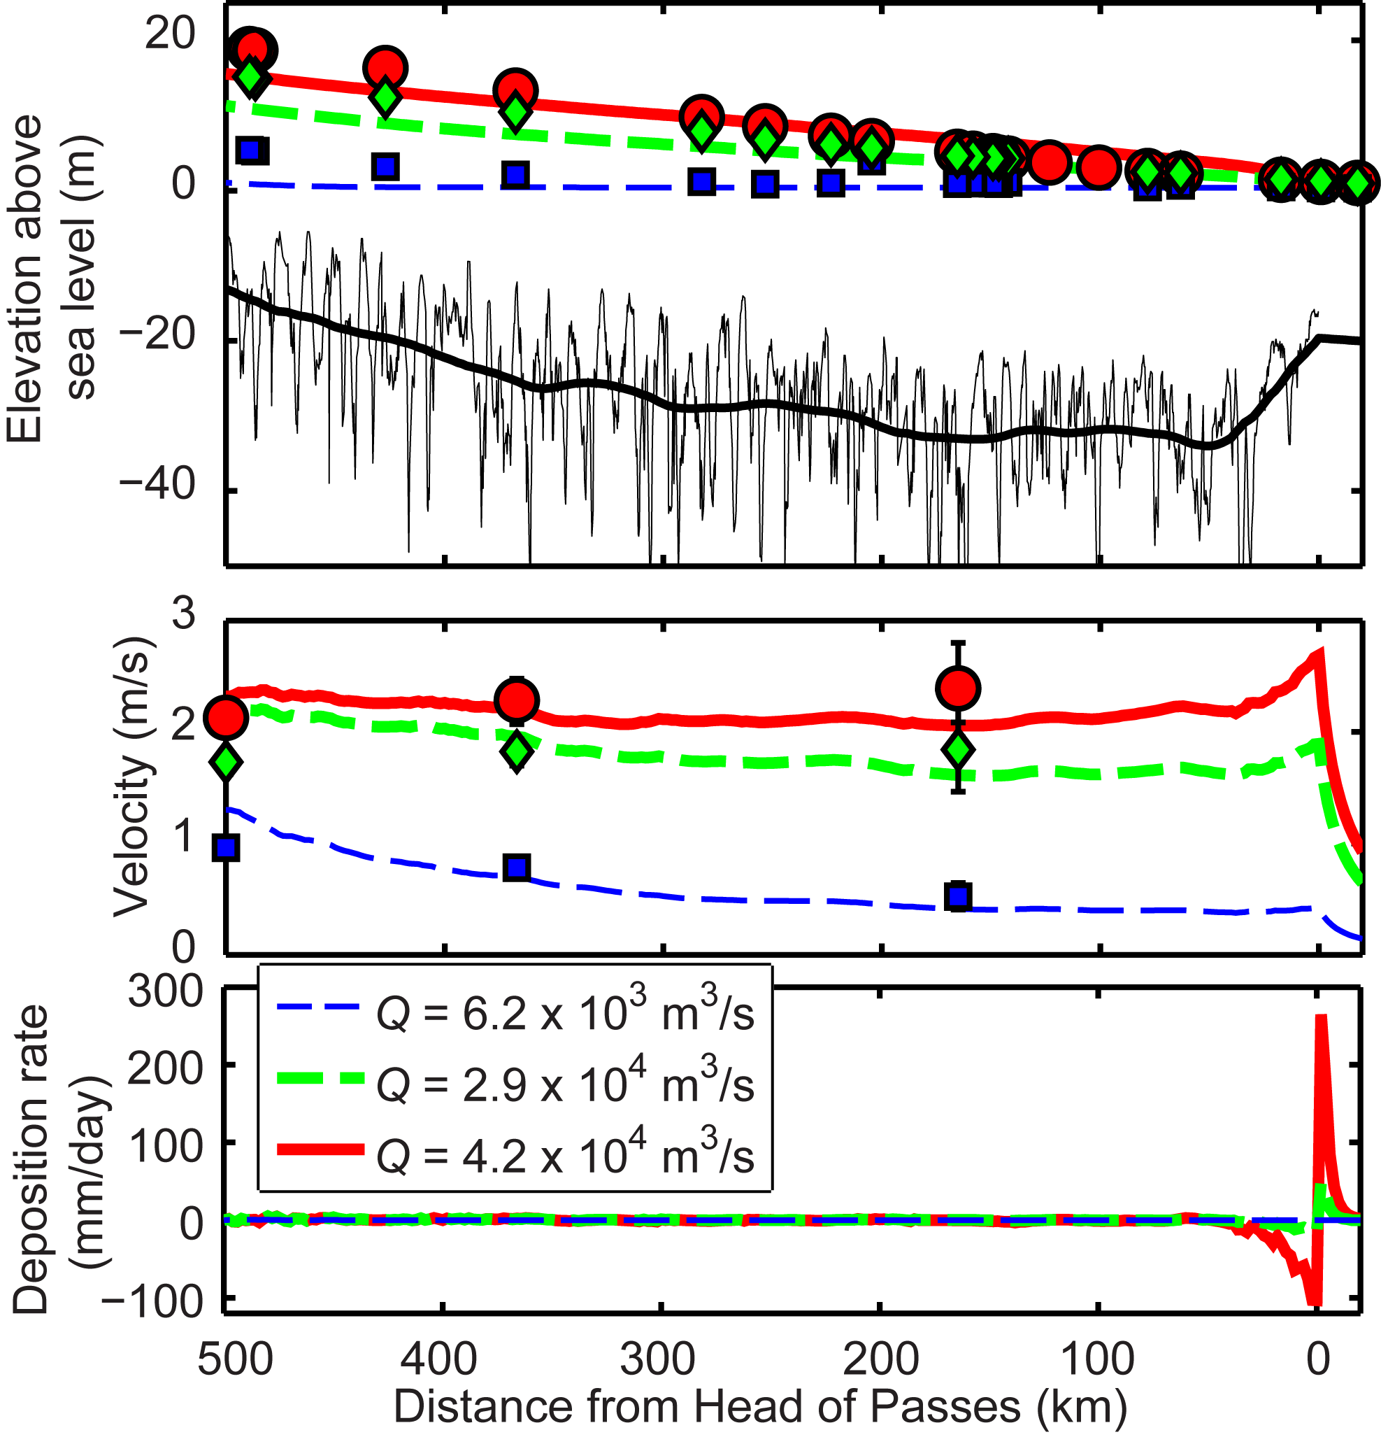
Backwater model matches observations for the Mississippi Delta over historic floods.
Events: Low flow, 1.9-yr flood, 27-yr flood.
Stage height variations are very small at the river mouth.
Transition from deposition to erosion occurs at Q = 30,000 m³/s (2-year flood).
Erosion near the river mouth happens often (in the absence of base-level fall).
Backwater length
River mouth
(Lamb et al., 2012, JGR)

Slide 22
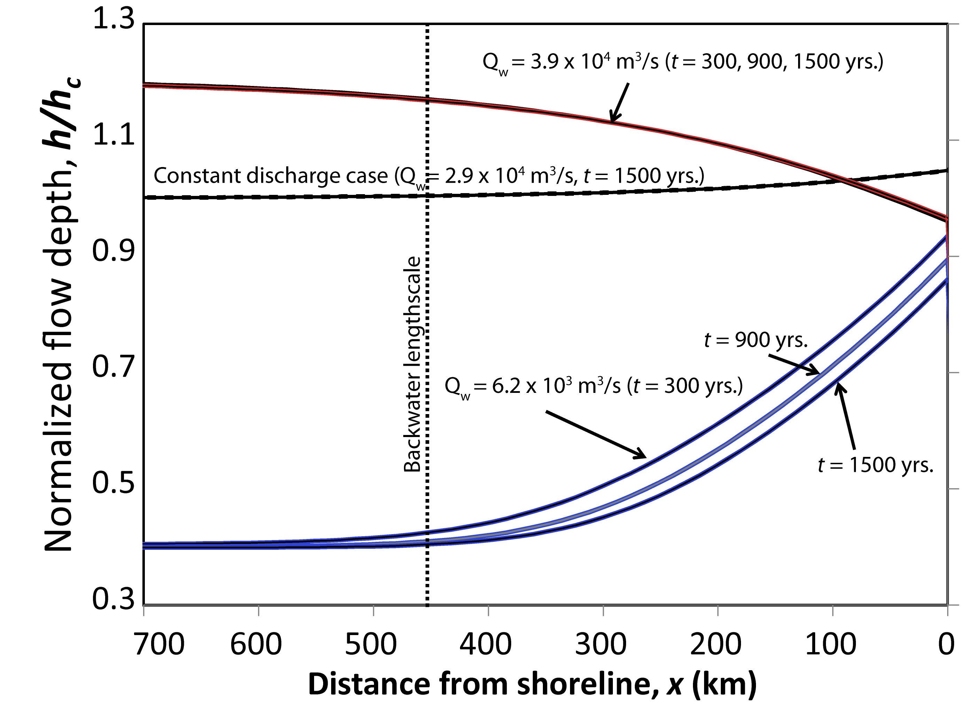
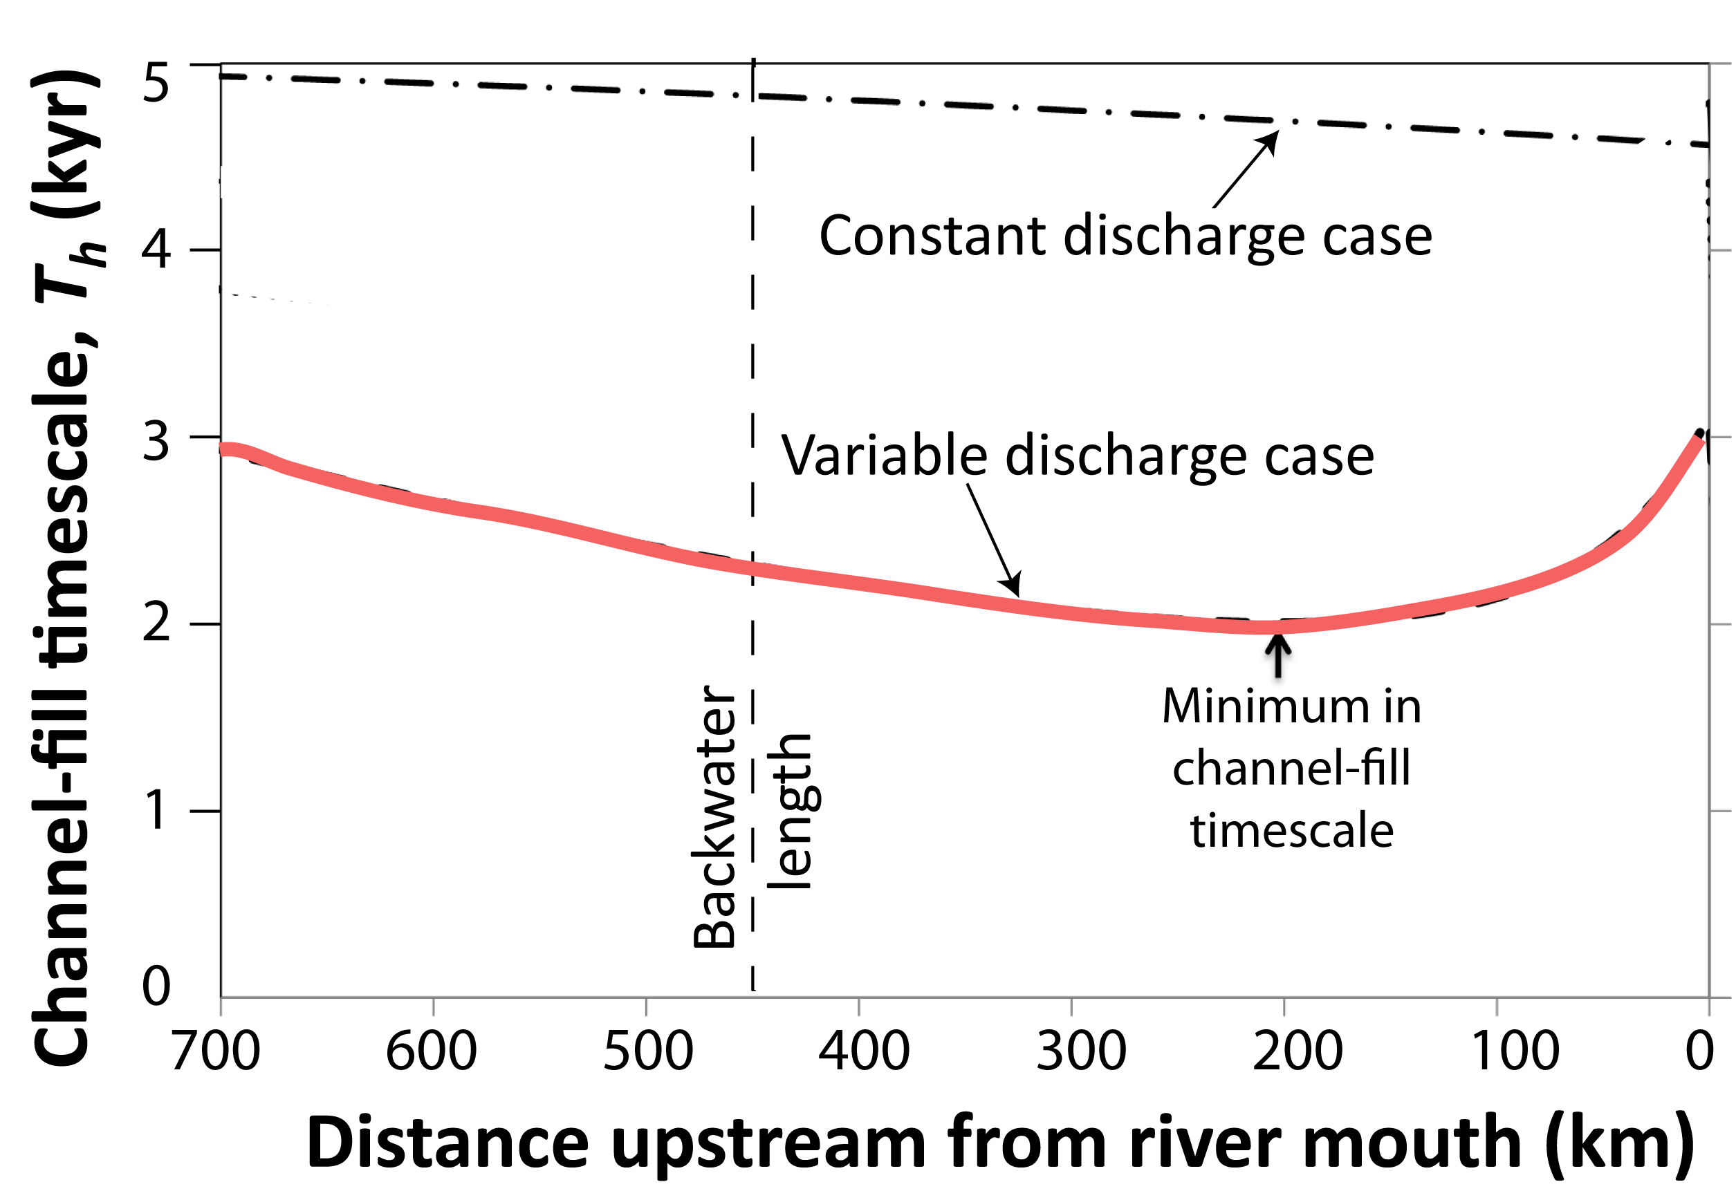
Backwater model produces a persistent node for avulsion for the Mississippi over the Holocene.
1. Reduced overbank flooding near the river mouth due to water-surface drawdown
2. Enhanced channel filling in the middle of the backwater zone resulting in a minimum channel-fill timescale.
T_{h}= h_{c} /v_{a}
River mouth
Simulations without backwater-induced erosion do not produce a persistent avulsion node.
(Chatanantavet, Lamb and Nittrouer, 2012, GRL)

Slide 23
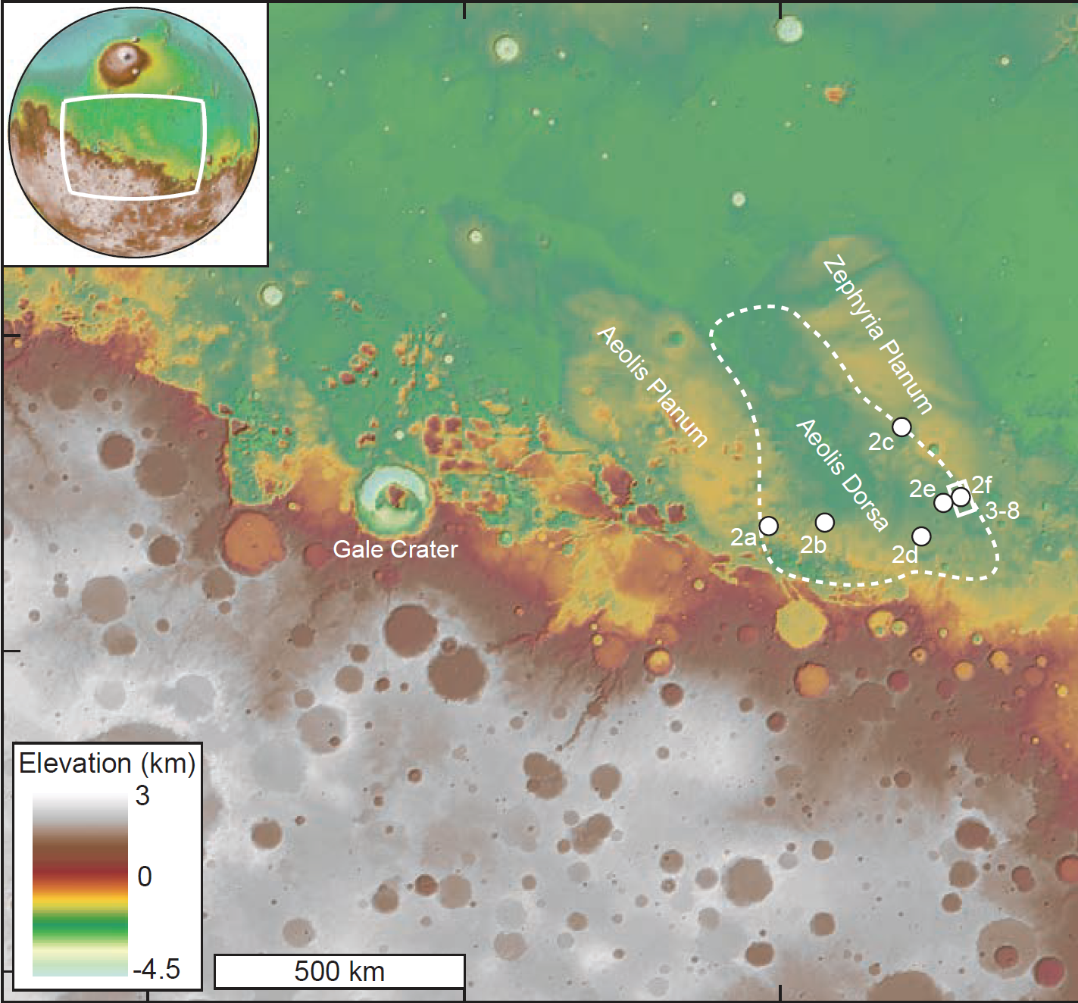
Application of delta-size scaling to Aeolis Dorsa, Mars
Our study area
Curiosity Rover
DiBiase, Limaye, Scheingross, Fischer and Lamb (2013, JGR-Planets)

Slide 24
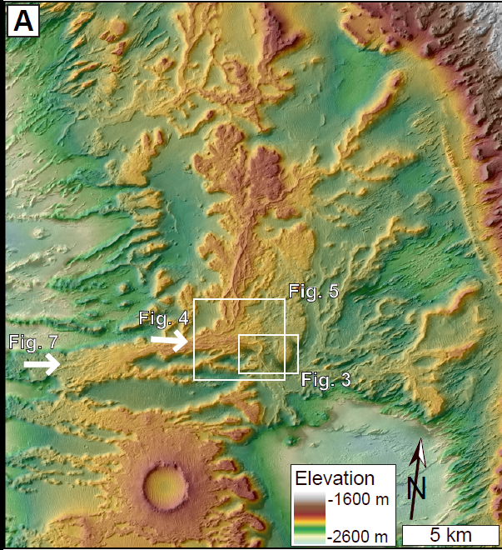
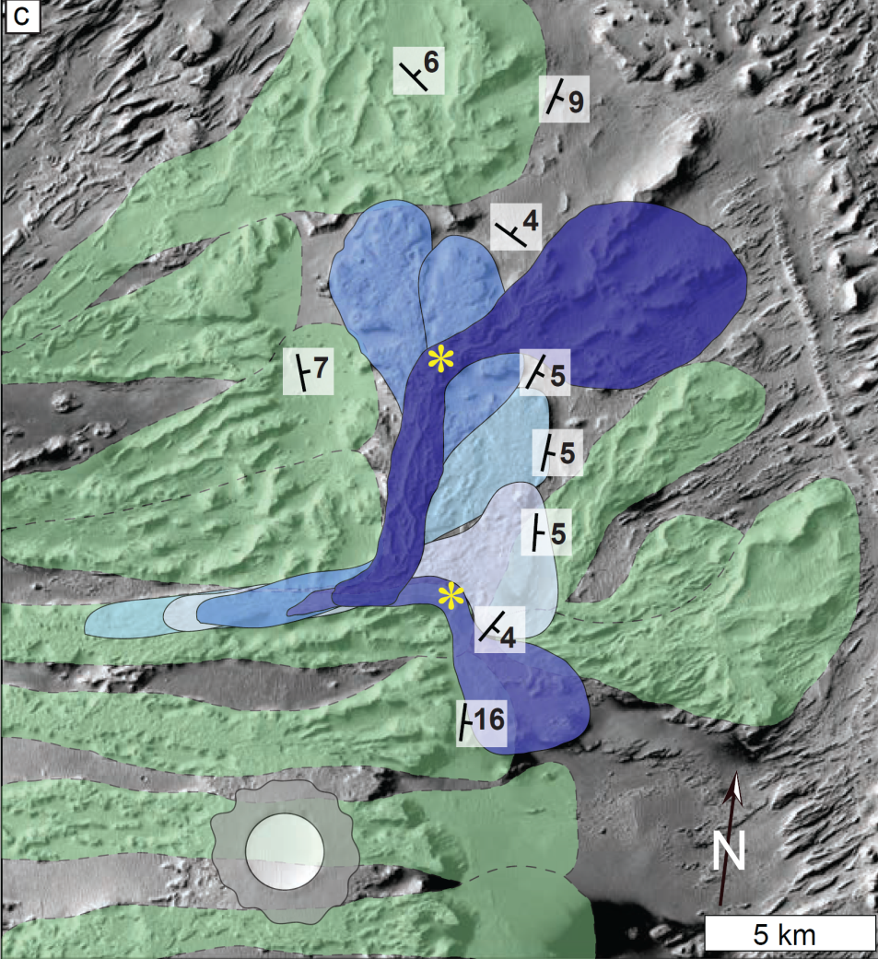
Evidence for an ancient delta on Mars
Depositional lobes and a consistent avulsion node.
Forsets dip in the downstream direction.
DiBiase, Limaye, Scheingross, Fischer and Lamb (2013, JGR-Planets)

Slide 25
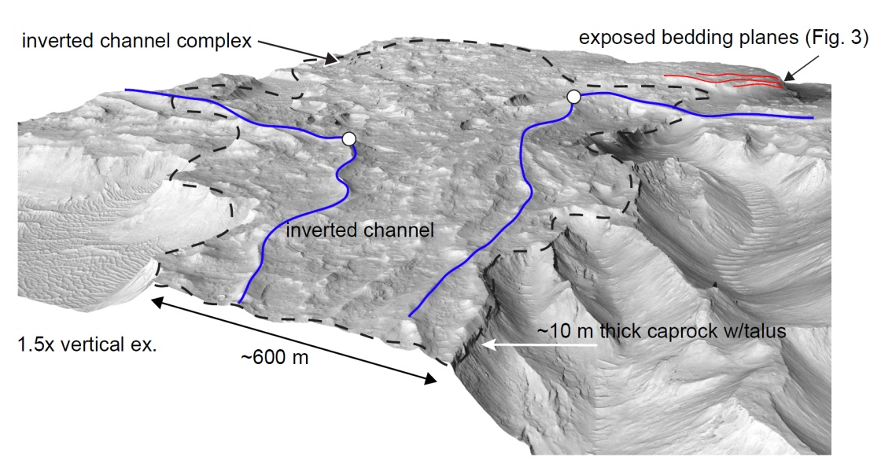
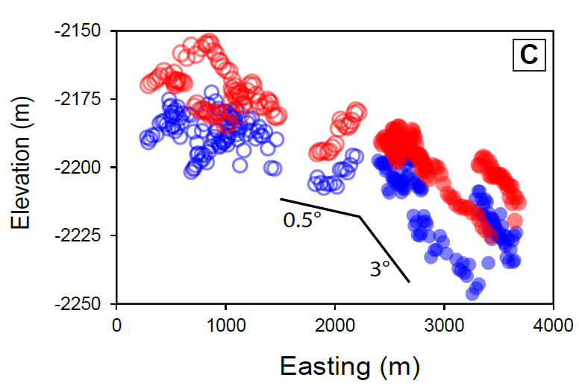
Preserved topset-forset slope break
Caprock thickness can be used as an estimate of channel depth (e.g., Mohrig et al., 2000).
DiBiase, Limaye, Scheingross, Fischer and Lamb (2013, JGR-Planets)

Slide 26
Delta-lobe size as a new paleo-hydraulic tool.
Channel slope estimated from backwater scaling: S = h/L_{b}
Given slope and depth, one can calculate flow velocity, discharge, sediment size, sediment flux, and depositional time.
Indicates water discharge of ~10³ m³/s for greater than ~ 10³ years.
L_{b}
DiBiase, Limaye, Scheingross, Fischer and Lamb (2013, JGR-Planets)

Slide 27
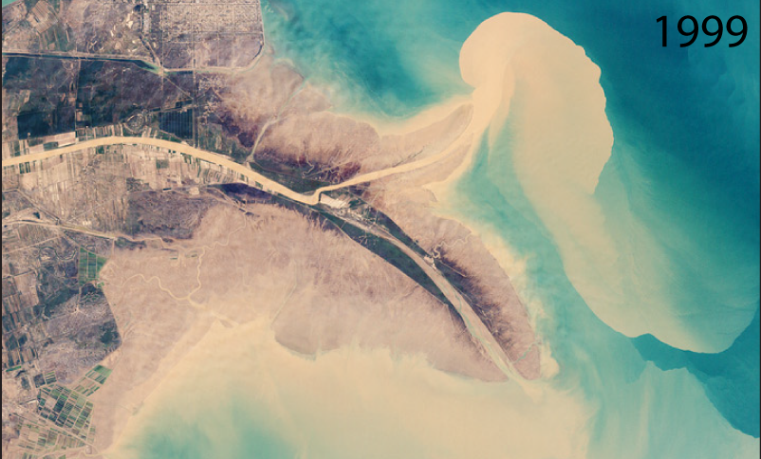
What sets the size of deltas?
NASA
10 km
NASA ESA
Backwater dynamics set a persistent avulsion node in coastal rivers that controls the size of deltas. Avulsions are more likely in the upstream part of the backwater zone due to enhanced channel filling there, and as a result of reduced overbank flow downstream caused by river-bed scour and water-surface drawdown.
Delta size scales with the backwater length, which in turn provides a powerful paleo-hydraulic tool for the sedimentary record on Earth and Mars.

Slide 28
For more information:
Nittrouer, J.A., Shaw, J., Lamb, M.P., Mohrig, D., 2012, Spatial and temporal trends for water-flow velocity and bed-material transport in the lower Mississippi River. Geological Society of America Bulletin, v. 124, p. 400-414, doi: 10.1130/B30497.1
Lamb, M.P., J. Nittrouer, D. Mohrig, J. Shaw, 2012, Backwater and river-plume controls on scour upstream of river mouths: Implications for fluvio-deltaic morphodynamics. Journal of Geophysical Research Earth Surface, v. 117, F01002, doi:10.1029/2011JF002079
*Chatanantavet, P., M. P. Lamb, and J. A. Nittrouer, 2012, Backwater controls on avulsion location on deltas, Geophys. Res. Lett., doi:10.1029/2011GL050197.
*DiBiase, R.A., *Limaye, A.B., *Scheingross, J.S., Fischer, W.W. and Lamb, M.P., 2013, Deltaic deposits at Aeolis Dorsa: Sedimentary evidence for a large body of water in the northern plains of Mars, Journal of Geophysical Research - Planets, v. 118, p. 1-18, doi: 10.1002/jgre.20100
*Chatanantavet, P. and Lamb, M.P., in review, Sediment transport and topographic evolution of a coupled river and river-plume system: An experimental and numerical study, Journal of Geophysical Research - Earth Surface.
Contact: Michael Lamb
mpl@gps.caltech.edu
PDFs of papers are here: http://geomorph.caltech.edu/publications

